Slide 1

Using AI based tools for literature research
AI Nugget
Dr. Ella Grieshammer – International Writing Lab – Department of Key Competencies Intercultural Interactions
Based on the presentation Literaturrecherche mit KI – Tipps und Tools by Universität Tübingen, licensed as CC BY 4.0, and the book Wissenschaftliches Schreiben mit KI, 2nd ed. (2026), by Isabella Buck. Unless otherwise stated, all content of this presentation is licensed under the CC BY 4.0 licence.

Slide 2
1. Learning Goals
  At the end of this nugget you know…
  Key features and ways of using Allrounders, Finders and Connectors for literature research.
  Factors influencing whether the use of AI tools in literature research is useful or not.
Notes:
There are various types of tools that can assist with literature research. Broadly speaking, a distinction can be made between all-rounders (which are not explicitly designed for literature research but are popular due to their familiarity and accessability) and so-called ‘finders’ and ‘connectors’ – AI-powered research tools that differ in their functions. As the specific subject context and publication preferences play a key role in determining whether the use of AI-powered literature search tools is beneficial, students should also learn under what circumstances the use of these tools is appropriate.

Slide 3
2. Groups of AI tools for literature research
Under certain conditions, AI integrating tools can support literature research.
There are
  Allrounder Tools, e.g. ChatAI, ChatGPT
  Finder Tools, e.g. Consensus, Elicit, Undermind, Scispace
  Connector Tools, e.g. Research Rabbit, Connected Papers, Litmaps
Notes:
All-rounders – text-generating AI in the form of chatbots, such as those now launched by many major software companies, including Gemini, Bing Copilot, Claude, DeepSeek…
Generally free of charge (at least in a limited version) and appealing to students due to their versatility
Search tools – tools specialised in searching databases and finding literature. Some are subject to a fee. Examples include Evidence Hunt, Google Scholar Labs, SciSpace, Keenious and R Discovery
Connector tools – tools that visualise publication networks. Examples include Inciteful, Open Knowledge Maps and Scite. Some are also subject to a fee.

Slide 4

2. Groups of AI tools for literature research
Allrounder Tools
  Text generating chatbots such as ChatAI, ChatGPT
  Not trained for academic literature research
  Web and database search often integrated
  Literature research often requires „Deep Research“ mode
  Advantage: free (trial) versions
  Disadvantage: possible errors (hallucinations) in references, long-lasting search
Notes:
Most modern chatbots now access the internet. Many also offer the option to enable a ‘deep research’ mode, in which the models conduct more extensive and thorough searches. Hallucinations are instances of misinformation that can never be entirely ruled out. For example, source details are frequently fabricated; the title or author may be correct, but the bibliographic information is incorrect.

Slide 5
2. Groups of AI tools for literature research
Allrounder tools
  May help to prepare conventional database search
  For example with the following prompt:
    "I am writing a [seminar/bachelor’s/master’s] thesis in my … semester. I study … and I am writing … on the topic of … . For my literature research, I need suitable keywords to search specifically for relevant academic sources on this topic in library catalogs and academic databases. Please create a list of relevant keywords in German and English that I can use for my search. Also make use of the Boolean operators AND, OR, and NOT. Additionally, apply truncation where appropriate.“
    Slightly modified and translated from: Buck, Isabella (2025): Wissenschaftlich schreiben mit KI. S. 158.
Notes:
When creating prompts, it is always important to provide as much context as possible so that the chatbot can provide the most appropriate response.
Boolean operators: originally derived from logic, these refine search queries in databases to yield better results: AND – links terms – only terms that appear together are searched for; OR – expands the search to include alternative terms; NOT – excludes irrelevant results
Truncation: This means searching for a word stem with different endings, e.g. verbs and nouns, or even compound words containing the word stem

Slide 6



2. Groups of AI tools for literature research
Finder Tools
  Examples: Consensus, Elicit, Undermind, Scispace
  Function:
    Search in academic databases
    Search based on key words or (research) question
    Often generate summaries of relevant papers
  Suitable for: Life and Natural Sciences – open access publications in English
  Less suitable for: Humanities, Social Sciences, Law, Theology – monografies, not open access
Notes:
Important: unlike general-purpose search tools, finder tools search in academic databases
Texts behind a paywall or in print are not found - the tool needs access to full-text articles in order to search them effectively
Articles from Life or Natural Sciences generally have a more consistent structure than articles in other disciplines, which is one reason why they are easier to search

Slide 7
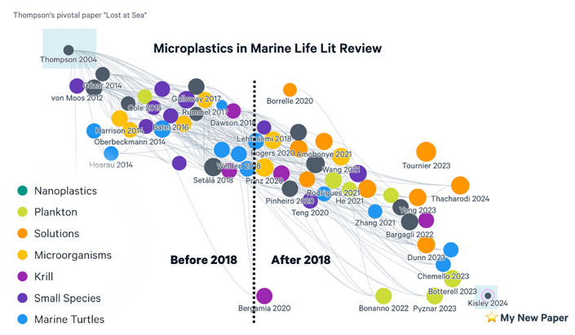
2. Groups of AI tools for literature research
Connector Tools
  Examples: Research Rabbit, Connected Papers, Litmaps
  Function:
    Generate visual interactive maps with a journal article as starting point
    Publication networks shows referencing and thematical nearness
  Condition for use: at least one relevant article
  Similar disciplinary limitations as with Connector Tools
Quelle: Litmaps
Notes:
Visualisations can help to understand the discourse
Again: access only to digital open-access texts

Slide 8
3. AI tools for literature research:
Limitations and conclusion
General limitations of AI based literature research tools:
  Partly with costs
  Privacy compliance?
  AI generated summaries may be flawed or biased
  Time saving benefit compared to conventional database research?
Notes:
Tools hosted by non-European companies do not comply with the GDPR (General Data Protection Regulation).

Slide 9
3. AI tools for literature research:
Limitations and conclusion
Possible conclusion on AI based literature research tools:
  Many tools, many promises
  Up to now several limitations, especially outside Life and Natural Sciences
  For some disciplines/topics useful in combination with conventional database research
Notes:
Big market of AI based research tools, each one promises to be even better than the others

Slide 10
4. Exercise
Choose the topic on which you will write your term papers, bachelor’s, or master’s thesis, or select an academic subject from your field of study that interests you.
If you already have a relevant academic article on this topic, use a connector tool to display related texts.
If you do not yet have an article, use a finder tool to search for literature on your topic.
Then research your topic in the subject catalogs of the SUB.
Finally, compare the results obtained through Ai based and conventional literature research.
Notes:
It makes sense here to provide students with tools (e.g. via QR code) that are free of charge and deemed appropriate for the subject in question.
Some time should be set aside to discuss the results. It is interesting to note the differences between the results of AI-based and conventional research, and how these differences arise.

Slide 11
4. Weiterführende Materialien (in German)
Das Video Teilaufgabe „Literaturarbeit“ aus dem KI-Campus-Kurs Prompt-Labor Hochschullehre – Anwendungen stellt die verschiedenen Arten und Möglichkeiten dar, KI im Literaturrechercheprozess zu nutzen: https://moodle.ki-campus.org/mod/videotime/view.php?id=29621 (Registrierung erforderlich, kostenfrei)
Die Präsentation Literaturrecherche mit KI – Tipps und Tools der Universität Tübingen stellt verschiedene Arten von Tools zur Literaturrecherche ausführlich vor und beschreibt die Eigenschaften einzelner Tools: https://www.oerbw.de/edu-sharing/components/render/f48da4bb-30b1-46fe-8da4-bb30b176fe84 (Lizenz CC BY 4.0)
Dieser Ratgeber enthält Hintergrundinformationen und Tipps unter anderem zum Umgang mit KI-Tools bei der Literaturrecherche: Buck, Isabella (2026): Wissenschaftliches Schreiben mit KI. 2. Auflage. UVK.
Notes:
These are some further materials in German for self-learning.

